Slide 1



CloudFront trust store pipeline
THREE STAGES
1 · Validate
Checks the bundle before AWS is touched
2 · Compare
How we add and remove client certificates — validated, compared certificate by certificate, and applied only when we choose
Every certificate, Git vs S3
3 · Apply
Only when someone picks ‘yes’
Kunal Shrivastava · Platform Engineering · October 2026
Notes:
Purpose: show the pipeline we now use for every request to add or remove a certificate in the CloudFront mTLS trust stores — how it is built, how a run flows, and why it is safe. Three stages: validate, compare, and apply only when someone chooses to.

Slide 2








Why trust store changes need care
CloudFront’s mTLS APIs let in only clients whose certificate comes from a CA in the trust store
HOW IT WORKS
Every change needs
checks
The right bundle for the right environment
Client app
CloudFront
Trust store
shows its certificate
mTLS API
the trusted CAs
A check that the bundle is valid
Trusted CA — let in
Any other CA — turned away
An exact list of what will be added or removed
A safe way to apply it — and to undo it
Like a guest list at reception: a visitor gets in only if their badge comes from someone on the list.
The pipeline builds all four into every run.
Notes:
CloudFront’s mTLS APIs only accept clients whose certificate was issued by a CA in the trust store — think of a guest list at reception. We get regular requests to add or remove certificates in tst, ppe and prd. One wrong entry can lock out a partner, or keep access open that should have been closed, so every change needs the four things on the right.

Slide 3




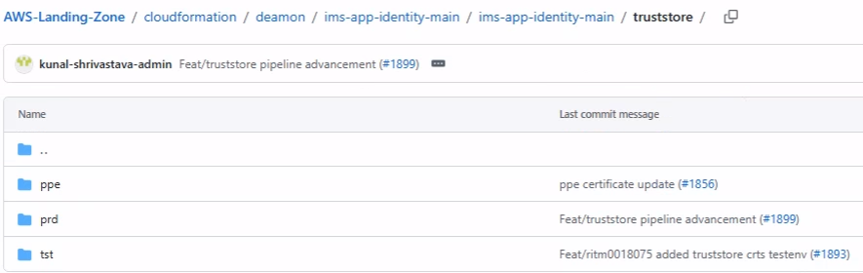


How it fits together
TRUST STORE
Git holds the certificates, the pipeline checks and applies them, CloudFront enforces them
GITHUB
AWS ACCOUNT FOR THE CHOSEN ENVIRONMENT
Git repository
Pipeline
S3 bucket
Trust store
mTLS APIs
One bundle per environment (tst, ppe, prd), changed by Pull Request
Validate → Compare → Apply, started by hand; Apply is ‘no’ by default
The current bundle, plus a new versioned file for every apply
The CA certificates CloudFront trusts
CloudFront lets in only clients with a trusted certificate
Environment | AWS role (alias) | Bundle in Git
tst | TST-NETWORK | truststore/tst/truststore.pem
ppe | PPE-NETWORK | truststore/ppe/truststore.pem
prd | NETWORK | truststore/prd/truststore.pem
No stored keys: short-lived OIDC role
Account must match the trust store
Bundles in Git one folder per environment, changed by Pull Request
Notes:
Left to right: the certificate bundles live in Git, one per environment, and change only through a Pull Request. The pipeline checks the bundle out, signs in to the chosen environment’s AWS account with a short-lived OIDC role (no stored keys), reads the current bundle from S3 and, on Apply, uploads a new versioned file and points the CloudFront trust store at it. CloudFront’s mTLS APIs then accept only clients whose certificate comes from a CA in the trust store. Full path in Git: cloudformation/deamon/ims-app-identity-main/ims-app-identity-main/truststore/<env>/truststore.pem. Region choice (eu-west-1 or us-east-1) is where the S3 bundle lives.

Slide 4






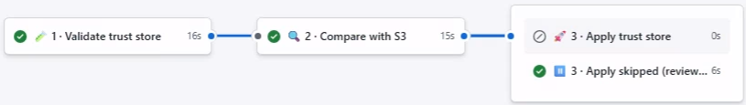
Validate, compare, then decide
TRUST STORE
Every run checks and compares — only Apply = yes changes anything in AWS
Apply = no
Report looks right?
Rerun with Apply = yes.
Start
1 · Validate
2 · Compare
Default. Review only — AWS is not changed
Pick environment, region and Apply (‘no’ by default)
Checks the bundle and settings, and confirms the AWS account
Fingerprints every certificate in Git and S3; lists the differences
Apply = yes
Active
3 · Apply: new bundle file, trust store updated
Waits until CloudFront confirms (up to 30 min)
a check fails
always
Run names
Stop
Report
“Trust Store · prd · Apply=no” in the run list
Bad bundle, unfinished settings or wrong account — AWS untouched
Every certificate, listed in the run summary
The run page Validate → Compare → Apply (or Apply skipped)
Notes:
Walk left to right. Start: pick the environment (tst, ppe or prd), the region where the S3 bundle lives, and Apply, which is ‘no’ by default. Validate: the team’s validator script and a certificate check run on the bundle in Git, unfinished settings stop the run, and the AWS account must match the trust store. Compare: every certificate in Git and in the current S3 bundle is fingerprinted and the differences are listed in the run summary. Apply = no ends there, with nothing changed. Apply = yes uploads a new versioned bundle, updates the trust store and waits until CloudFront reports it Active. Only one run per environment can happen at a time.

Slide 5
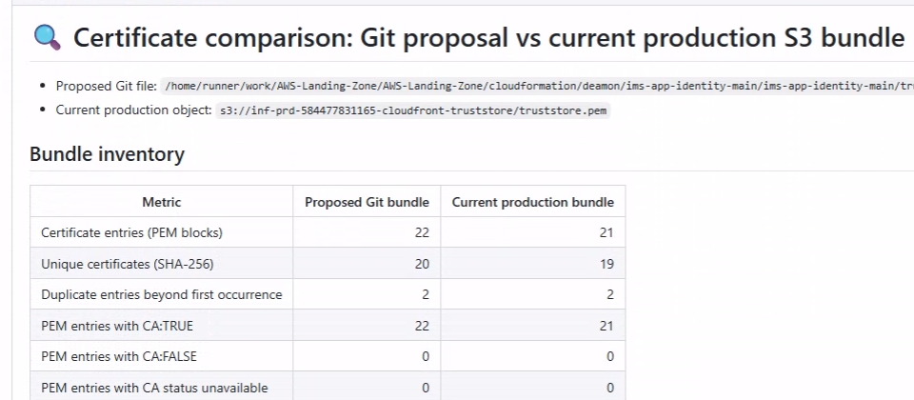

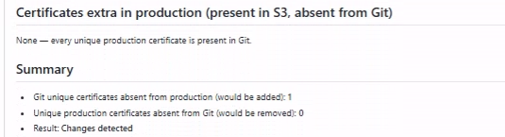


Every certificate, compared
TRUST STORE
Git vs the current S3 bundle, matched by each certificate’s SHA-256 fingerprint
Exact matching
Each certificate has a unique fingerprint: the same certificate always matches, a different one never does.
What the report shows
Inventory: totals, duplicates, CA and non-CA, side by side
Every certificate in S3: name, issuer, expiry — is it in Git?
Every certificate in Git — is it already in S3?
Extras in S3: certificates that would be removed
Summary: how many would be added and removed
How to read the remarks
Exists in Git / prod
no change
Not present in prod
will be added
Extra in prod
will be removed
Comparison report from a real prd run (Apply = no): inventory, then the summary
Notes:
This is the heart of the pipeline. Both bundles — the proposal in Git and the current bundle in S3 — are split into individual certificates and each one is fingerprinted with SHA-256, so matching is exact and does not depend on how the file is laid out. The report in the run summary lists an inventory (totals, duplicates, CA and non-CA), every certificate now in S3 with its name, issuer and expiry and whether Git has it, every certificate in Git and whether S3 already has it, the extras that would be removed, and a final count of additions and removals. It also flags duplicates and any certificate OpenSSL cannot read. The remarks name the environment — ‘prod’ for prd (shown here), ‘tst’ and ‘ppe’ for the others.

Slide 6
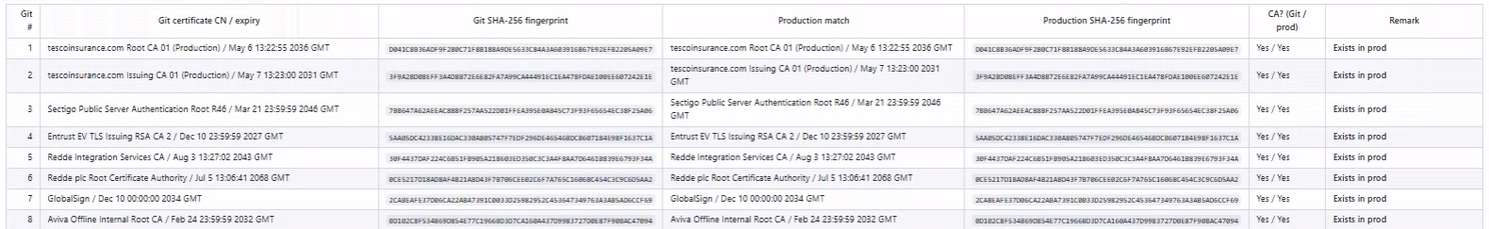
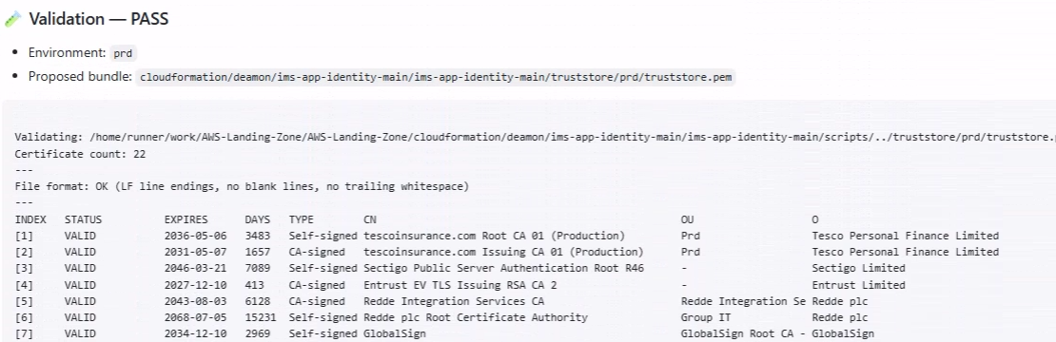

Certificate by certificate
TRUST STORE
From a real prd run with Apply = no — every certificate validated, then matched by fingerprint
Compare every certificate in Git, matched to the same certificate in production
Validate every certificate in the bundle, with its expiry date and days left
Expiry at a glance
The DAYS column shows how long each certificate has left — the starting point for expiry alerts.
Notes:
Two parts of the run summary from a real prd run with Apply = no. Top: the comparison table — every certificate in the Git bundle, its SHA-256 fingerprint, the matching certificate in production and the remark. Bottom: the validation step — every certificate in the bundle with its status, expiry date and days left, plus a file-format check. Nothing was changed by this run.

Slide 7


Applying a change, safely
TRUST STORE
Runs only when someone picks Apply = yes — and keeps every earlier bundle for an easy undo
1
Checks the account again
The run summary records
The role’s account must match the trust store, or nothing happens
2
Uploads a new bundle file
The environment and trust store
Saved as truststore-<run>.pem; earlier files are never overwritten
The new bundle file now in use
3
Updates the trust store
CloudFront’s status: active
Uses CloudFront’s version check (ETag), so it never overwrites a parallel change
That the previous file was kept
4
Waits for CloudFront
Checks every 15 seconds until the trust store is Active, for up to 30 minutes
Every bundle kept
5
Records the result
Environment, trust store, new bundle file and final status in the run summary
Each apply adds a new truststore-<run>.pem file to S3. Earlier files are never overwritten, so any previous bundle can be put back.
Easy undo: revert the change in Git and run again — or point the trust store back to the previous bundle file, still in S3.
Notes:
Apply runs only when someone picks Apply = yes, and only after validation and comparison have passed in the same run. It re-checks the AWS account, uploads the Git bundle to S3 as a new file named after the run (earlier files are never overwritten), updates the trust store using CloudFront’s ETag version check, then polls every 15 seconds until CloudFront reports the trust store Active, failing loudly if it reports failed or takes more than 30 minutes. To undo: revert the Git change and run again, or point the trust store back at the previous bundle file, which is still in S3.

Slide 8



Why it works well
TRUST STORE
Good for: every request to add or remove a certificate, in tst, ppe and prd
Every certificate checked
Nothing changes by default
How we use it
Matched by fingerprint — see exactly what would be added or removed.
Apply is ‘no’ unless someone picks ‘yes’; a run validates and compares.
1
Edit the bundle in Git and raise a Pull Request
Bad bundles stop early
Always the right account
2
Run with Apply = no and read the report
The validator and certificate checks run before AWS is touched.
Short-lived OIDC role, and its account must match the trust store.
3
Happy with it? Run again with Apply = yes
Safe, versioned updates
A clear record
4
Check the summary shows Active
A new file per apply, a version check, one run per environment.
Git shows who changed what; each run shows the checks, report and result.
Notes:
Six reasons it works well. Worth saying how we use it: with Apply = yes the change goes in straight after the comparison in the same run, so our practice is always a review-only run first (Apply = no), read the report, then run again with Apply = yes — especially for prd.

Slide 9




What’s next
Ideas to build on what’s already working
Expiry alerts
Scheduled checks
Approval for prd
Ready for more
The report already lists every expiry date — flag certificates due to expire within 30 days.
A weekly review-only run spots any difference between Git and S3 early.
A named approver before Apply = yes runs in production.
Adding a trust store or environment is one more settings block.
Today: every certificate change is validated, compared, and applied only when we choose.
Notes:
Ideas, not commitments — useful to hear which matter most to the client. Expiry alerts reuse the expiry dates the report already reads. A scheduled review-only run would surface any difference between Git and S3 early. An approver step for prd adds a second pair of eyes before Apply = yes. And the settings are per environment, so another trust store or environment is a small addition.

